Slide 1
WRES2203 Advanced Network Technology Chapter 9: Frame Relay
Connecting Networks
Notes:
Cisco Networking Academy program
Connecting Networks
Chapter 4: Frame Relay

Slide 2
Chapter 4
4.0 Introduction
4.1 Introduction to Frame Relay
4.2 Configuring Frame Relay
4.3 Troubleshooting Connectivity
4.4 Summary
Notes:
Chapter 4

Slide 3
Chapter 4: Objectives
Describe the fundamental concepts of Frame Relay technology, including operation, implementation requirements, maps, and Local Management Interface (LMI) operation.
Configure a basic Frame Relay permanent virtual circuit (PVC), including configuring and troubleshooting Frame Relay on a router serial interface and configuring a static Frame Relay map.
Describe advanced concepts of Frame Relay technology, including subinterfaces, bandwidth, and flow control.
Configure an advanced Frame Relay PVC, including solving reachability issues, configuring subinterfaces, and verifying and troubleshooting a Frame Relay configuration.
Notes:
Chapter 4: Objectives

Slide 4
4.1 Introduction to Frame Relay
Notes:
Cisco Networking Academy program
Connecting Networks
Chapter 4: Frame Relay

Slide 5
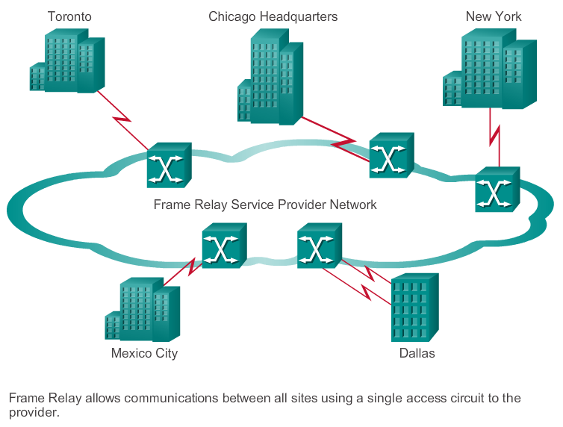
Benefits of Frame Relay Introducing Frame Relay
Notes:
4.1.1.1 Introducing Frame Relay

Slide 6
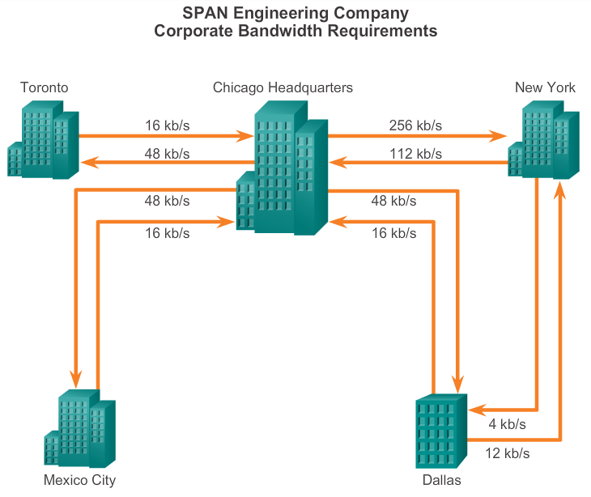
Benefits of Frame Relay Benefits of Frame Relay WAN Technology
Bandwidth requirements can be varied
Notes:
4.1.1.2 Benefits of Frame Relay WAN Technology

Slide 7
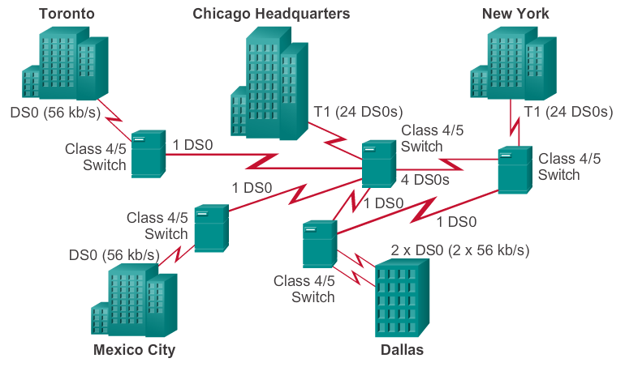
Benefits of Frame Relay Dedicated Line Requirements
Leased line limitation: Fixed bandwidth
Notes:
4.1.1.3 Dedicated Line Requirements

Slide 8
Benefits of Frame Relay Frame Relay Cost Effectiveness and Flexibility
With dedicated lines, customers pay for an end-to-end connection, which includes the local loop and the network link. With Frame Relay, customers only pay for the local loop, and for the bandwidth, they purchase from the network provider.
Frame Relay shares bandwidth across a larger base of customers. Typically, a network provider can service 40 or more 56 kb/s customers over one T1 circuit. Using dedicated lines would require more CSU/DSUs (one for each line) and more complicated routing and switching.
Notes:
4.1.1.4 Cost Effectiveness and Flexibility of Frame Relay

Slide 9
Frame Relay Operation Virtual Circuits
Switched virtual circuits (SVC) – Established dynamically by sending signaling messages to the network.
Permanent virtual circuits (PVCs) – Preconfigured by the carrier, and after they are set up, only operate in DATA TRANSFER and IDLE modes.
VCs are identified by DLCIs. Frame Relay DLCIs have local significance, which means that the values are not unique in the Frame Relay WAN. A DLCI identifies a VC to the equipment at an endpoint.
A DLCI has no significance beyond the single link.
Notes:
4.1.2.1 Virtual Circuits

Slide 10
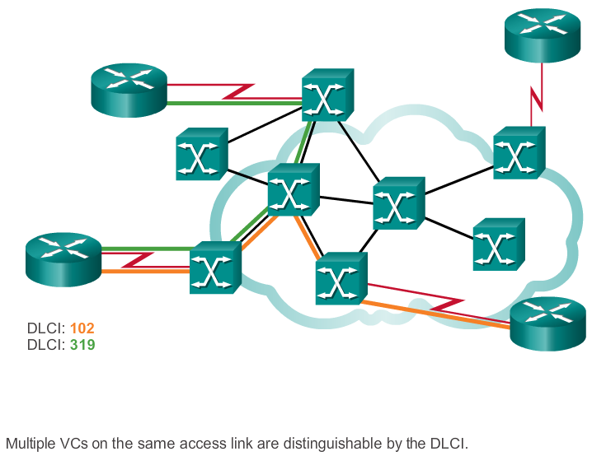
Frame Relay Operation Multiple Virtual Circuits
Notes:
4.1.2.2 Multiple Virtual Circuits

Slide 11
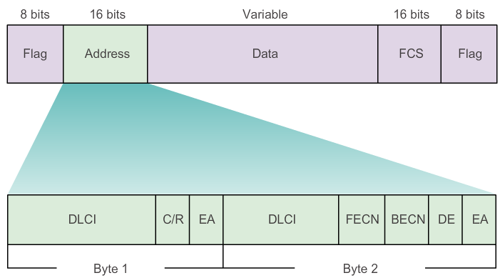
Frame Relay Operation Frame Relay Encapsulation
Extended Address (EA) - If the value of the EA field is 1, the current byte is determined to be the last DLCI octet.
Although current Frame Relay implementations all use a two-octet DLCI,
this capability does allow longer DLCIs in the future. The eighth bit of each byte of the Address field indicates the EA.
Notes:
4.1.2.3 Frame Relay Encapsulation

Slide 12
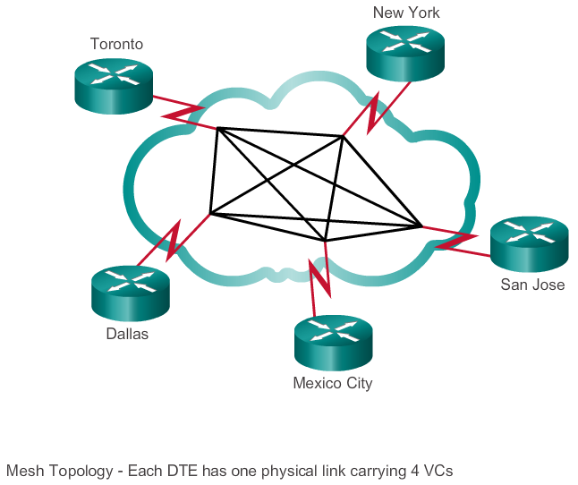
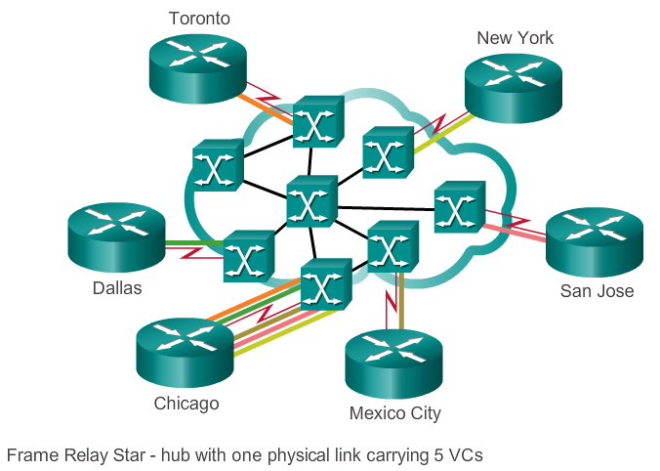
Frame Relay Operation Frame Relay Topologies
Notes:
4.1.2.4 Frame Relay Topologies
4.1.2.5 Frame Relay Topologies (Cont.)

Slide 13
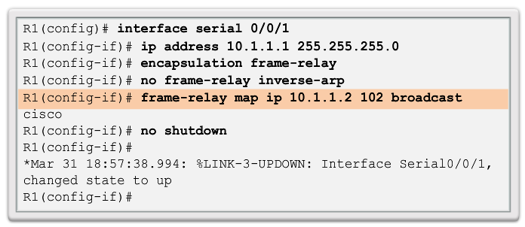
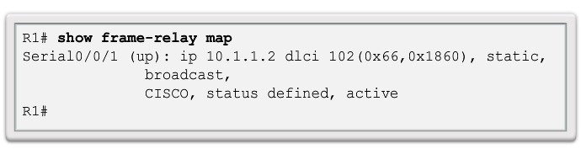
Frame Relay Operation Frame Relay Address Mapping
Notes:
4.1.2.6 Frame Relay Address Mapping

Slide 14
Frame Relay Operation Local Management Interface (LMI)
Basically, the LMI is a keepalive mechanism that provides status information about Frame Relay connections between the router (DTE) and the Frame Relay switch (DCE).
Every 10 seconds or so, the end device polls the network, either requesting a dumb sequenced response or channel status information. If the network does not respond with the requested information, the user device may consider the connection to be down.
When the network responds with a FULL STATUS response, it includes status information about DLCIs that are allocated to that line. The end device can use this information to determine whether the logical connections are able to pass data.
Notes:
4.1.2.7 Local Management Interface (LMI)

Slide 15
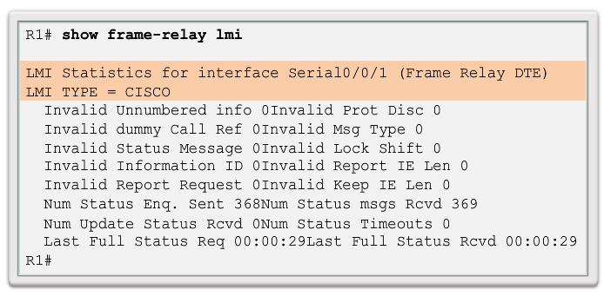
Frame Relay Operation Local Management Interface (LMI)
Notes:
4.1.2.7 Local Management Interface (LMI)

Slide 16
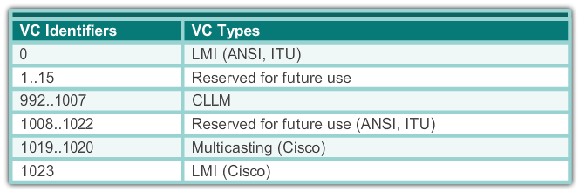
Frame Relay Operation LMI Extensions
VC status messages
Multicasting
Global addressing
Simple flow control
Notes:
4.1.2.8 LMI Extensions

Slide 17
Frame Relay Operation Using LMI and Inverse ARP to Map Addresses
The Inverse ARP request includes the source hardware, source Layer 3 protocol address, and the known target hardware address.
The Inverse ARP request fills the target Layer 3 protocol address field with all zeroes. It encapsulates the packet for the specific network and sends it directly to the destination device using the VC.
Upon receiving an Inverse ARP request, the destination device uses the source device’s address to create its own DLCI-to-Layer 3 map.
It then sends an Inverse ARP response that includes its Layer 3 address information.
When the source device receives the Inverse ARP response, it completes the DLCI-to-Layer 3 map using the provided information.
Notes:
4.1.2.9 Using LMI and Inverse ARP to Map Addresses

Slide 18
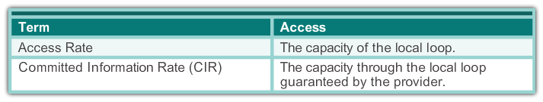
Advanced Frame Relay Concepts Access Rate and Committed Information Rate
Notes:
4.1.3.1 Access Rate and Committed Information Rate

Slide 19
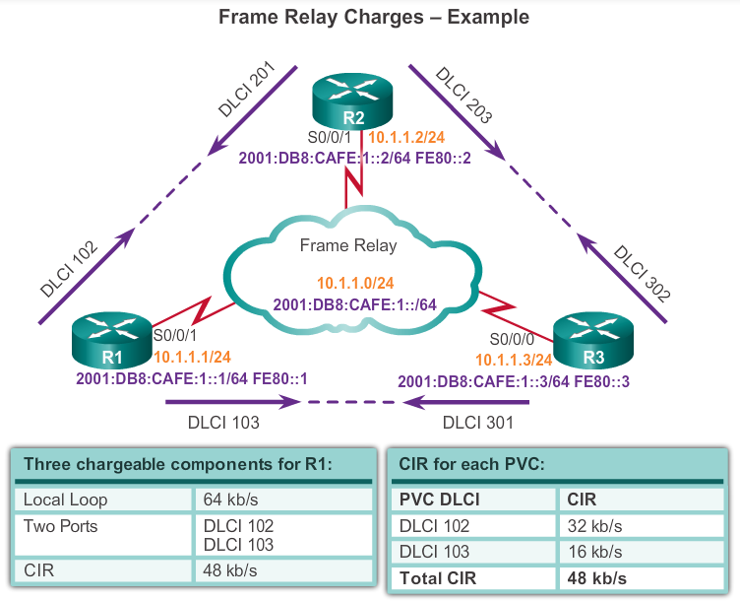
Advanced Frame Relay Concepts Frame Relay Example
Notes:
4.1.3.2 Frame Relay Example

Slide 20
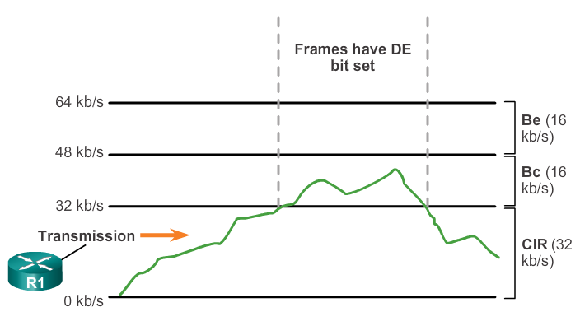
Advanced Frame Relay Concepts Bursting
Committed Information Rate (CIR). The average rate (in bit/s) at which the network guarantees to transfer information units over a measurement interval T. This T interval is defined as: T = Bc/CIR.
Committed Burst Size (BC). The maximum number of information units transmittable during the interval T.
Excess Burst Size (BE). The maximum number of uncommitted information units (in bits) that the network will attempt to carry during the interval.
Notes:
4.1.3.3 Bursting

Slide 21
Advanced Frame Relay Concepts Frame Relay Flow Control
When the DCE sets the BECN bit to 1, it notifies devices in the direction of the source (upstream) that there is congestion on the network.
When the DCE sets the FECN bit to 1, it notifies devices in the direction of the destination (downstream) that there is congestion on the network.
DTE devices can set the value of the DE bit to 1 to indicate that the frame has lower importance than other frames. When the network becomes congested, DCE devices discard the frames with the DE bit set to 1 before discarding those that do not.
FECN=Forward Explicit Congestion Notification bit
BECN=Backward Explicit Congestion Notification bit
DE=Discard Eligibility bit
Notes:
4.1.3.4 Frame Relay Flow Control

Slide 22
4.2 Configuring Frame Relay
Notes:
Cisco Networking Academy program
Connecting Networks
Chapter 4: Frame Relay

Slide 23
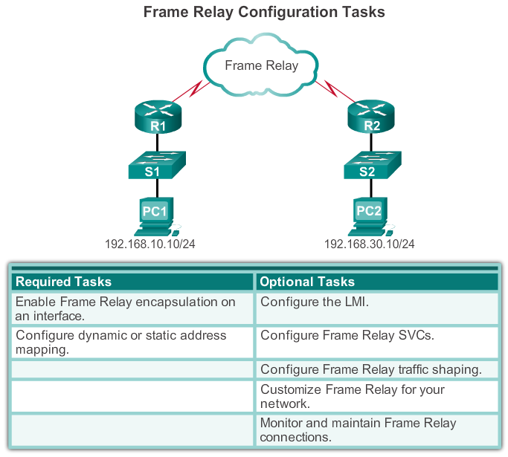
Configure Basic Frame Relay Basic Frame Relay Configuration Steps
Notes:
4.2.1.1 Basic Frame Relay Configuration Commands

Slide 24
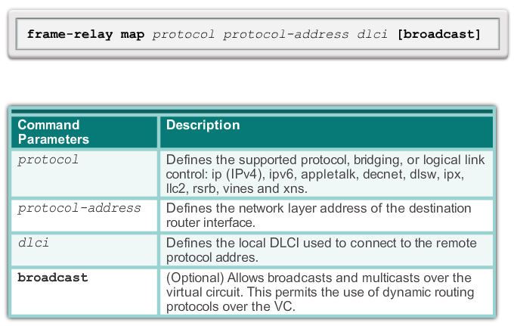
Configure Basic Frame Relay Configuring a Static Frame Relay Map
Notes:
4.2.1.2 Configuring a Static Frame Relay Map

Slide 25
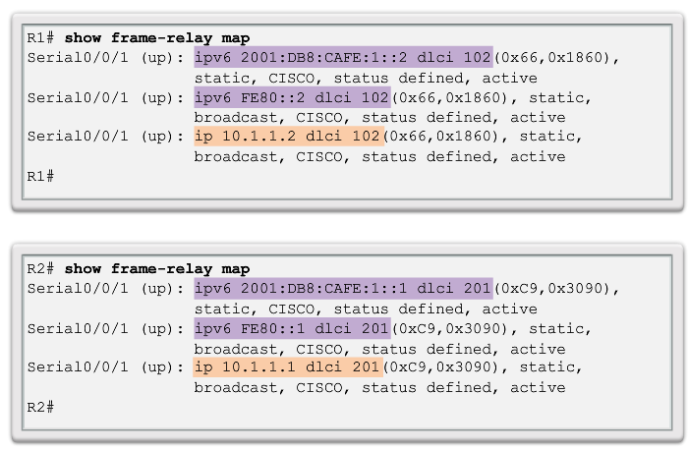
Configure Basic Frame Relay Verifying a Static Frame Relay Map
Notes:
4.2.1.3 Verify a Static Frame Relay Map

Slide 26
Configure Subinterfaces Reachability Issues
Frame Relay networks provide NBMA connectivity, using a hub-and-spoke topology, between remote sites. In an NBMA Frame Relay topology, when a single multipoint interface must be used to interconnect multiple sites, routing update reachability issues may result.
Reachability Issues:
Split horizon
Broadcast/multicast replication
Neighbor Discovery: DR and BDR
Notes:
4.2.2.1 Reachability Issues

Slide 27
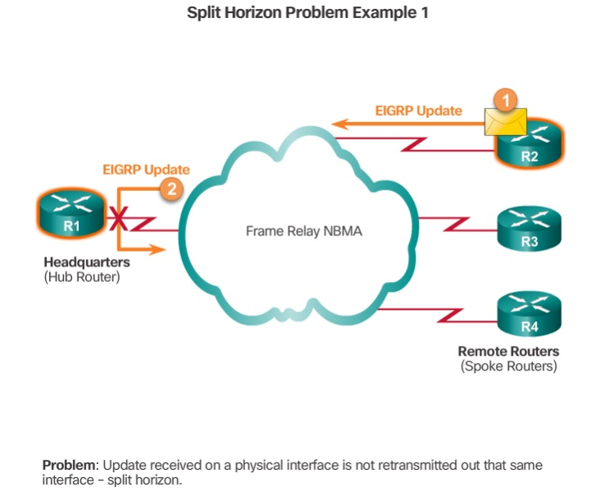
Configure Subinterfaces Split horizon
Notes:
4.2.2.1 Reachability Issues

Slide 28
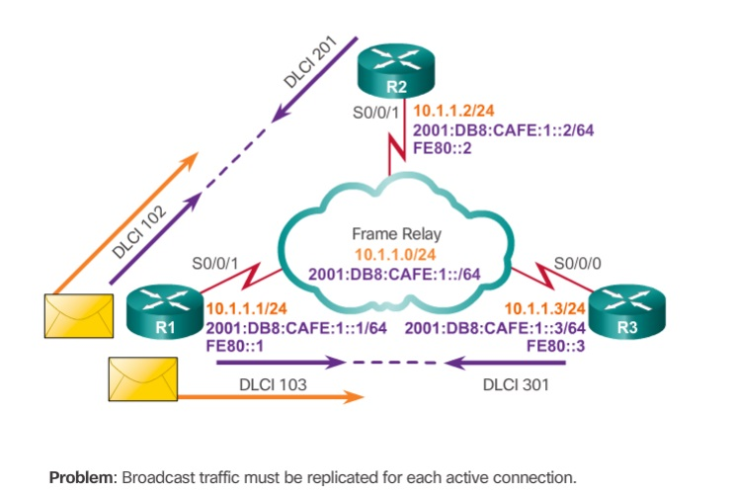
Configure Subinterfaces Multicast and Broadcast Replication
These replicated packets consume bandwidth and cause significant latency variations in user traffic.
Notes:
4.2.2.1 Reachability Issues

Slide 29
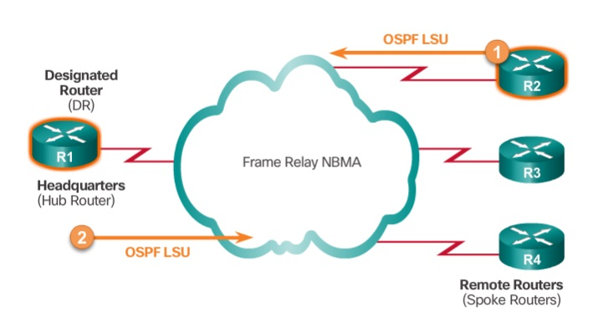
Configure Subinterfaces Neighbor Discovery: DR and BDR
OSPF over NBMA networks works in non-broadcast network mode, by default, and neighbors are not automatically
discovered. Neighbors can be statically configured. Recall that a NBMA network behaves like Ethernet, and on Ethernet,
a DR is needed to exchange routing information between all routers on a segment. Therefore, only the hub router can
act as a DR, because it is the only router that has PVCs with all other routers.
http://www.cisco.com/c/en/us/support/docs/ip/open-shortest-path-first-ospf/13690-18.html
Notes:
4.2.2.1 Reachability Issues

Slide 30

Configure Subinterfaces Solving Reachability Issues
Disable split horizon – One method for solving the reachability issues that are produced by split horizon may be to turn off split horizon; however, disabling split horizon increases the chances of routing loops in your network.
Full-meshed topology – Another method is to use a full-meshed topology; however, this topology increases costs.
Subinterfaces – In a hub-and-spoke Frame Relay topology, the hub router can be configured with logically assigned interfaces called subinterfaces.
Notes:
4.2.2.2 Solving Reachability Issues

Slide 31
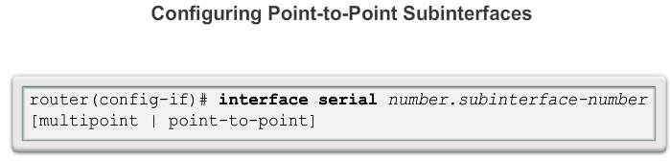
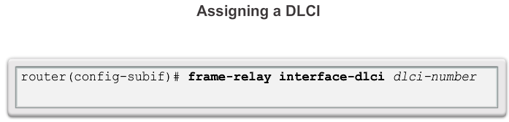
Configure Subinterfaces Configuring Point-to-Point Subinterfaces
Notes:
4.2.2.3 Configuring Point-to-Point Subinterfaces

Slide 32
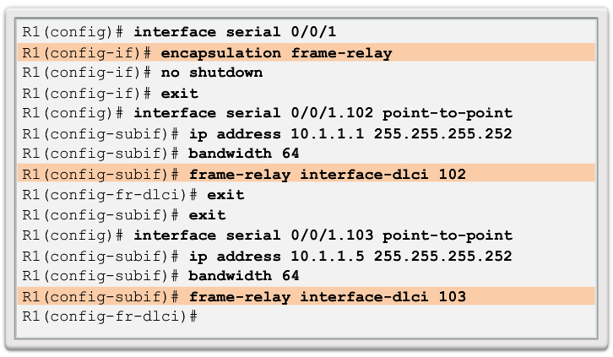
Configure Subinterfaces Example: Configuring Point-to-Point Subinterfaces
Notes:
4.2.2.4 Example: Configuring Point-to-Point Subinterfaces

Slide 33
4.3 Troubleshooting Connectivity
Notes:
Cisco Networking Academy program
Connecting Networks
Chapter 4: Frame Relay

Slide 34
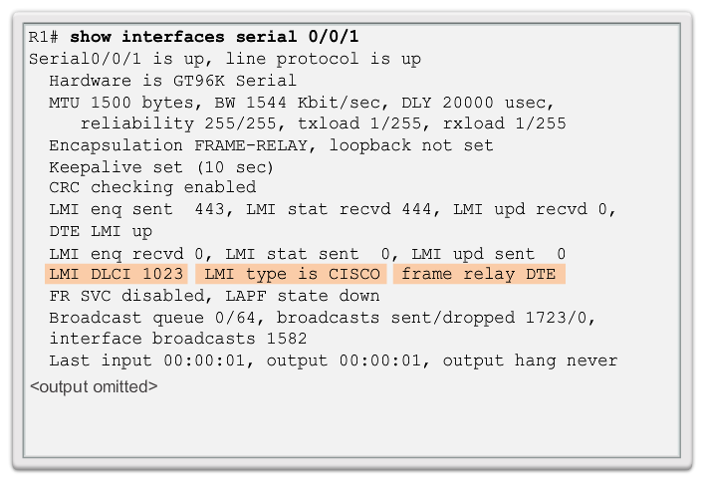
Troubleshoot Frame Relay Verifying Frame Relay Operation: Frame Relay Interface
Notes:
4.3.1.1 Verifying Frame Relay Operation: Frame Relay Interface

Slide 35
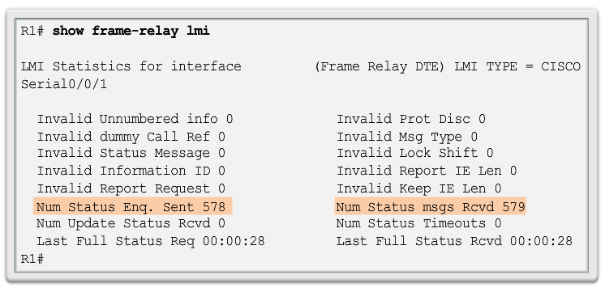
Troubleshoot Frame Relay Verifying Frame Relay Operation: LMI Operations
Notes:
4.3.1.2 Verifying Frame Relay Operation: LMI Operations

Slide 36
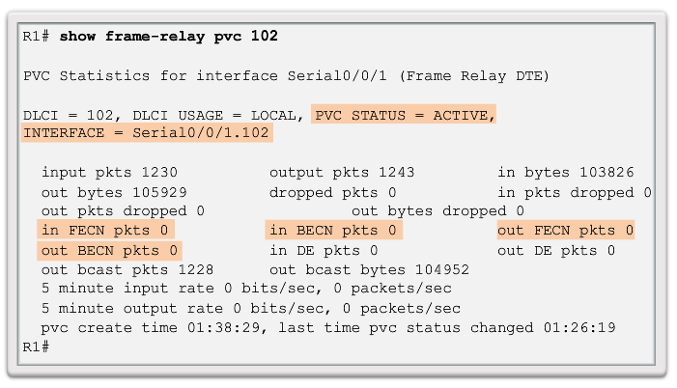
Troubleshoot Frame Relay Verifying Frame Relay Operation: PVC Status
Notes:
4.3.1.3 Verifying Frame Relay Operation: PVC Status

Slide 37
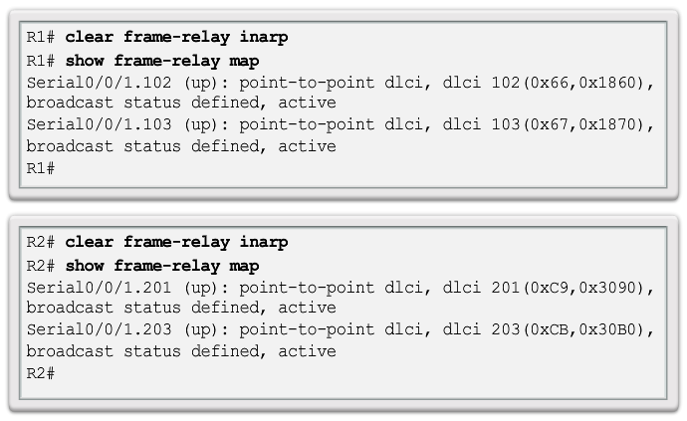
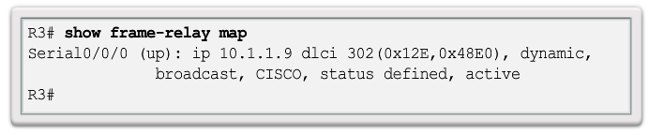
Troubleshoot Frame Relay Verifying Frame Relay Operation: Inverse ARP
Notes:
4.3.1.4 Verifying Frame Relay Operation: Inverse ARP

Slide 38
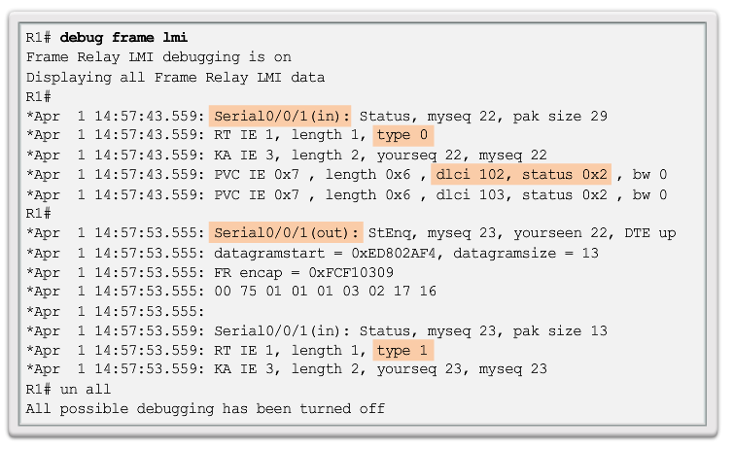
Troubleshoot Frame Relay Troubleshooting Frame Relay Operation
Notes:
4.3.1.5 Troubleshooting Frame Relay Operation

Slide 39
Chapter 4: Summary
This chapter described:
The fundamental concepts of Frame Relay technology, including operation, implementation requirements, maps, and Local Management Interface (LMI) operation.
How to configure a basic Frame Relay permanent virtual circuit (PVC), including configuring and troubleshooting Frame Relay on a router serial interface and configuring a static Frame Relay map.
Advanced concepts of Frame Relay technology including subinterfaces, bandwidth and flow control.
Advanced Frame Relay PVCs, including solving reachability issues, configuring subinterfaces, and verifying and troubleshooting a Frame Relay configuration.
Notes:
Chapter 4 Summary

Slide 40


